Slide 1
Enzymatic and other Biochemical Reactions
Notes:
The linkage between organic chemistry and biological function is the catalysis and self-assembly behavior of biomolecules. Primarily, this means the interactions of proteins with other molecules in the cell.

Slide 2
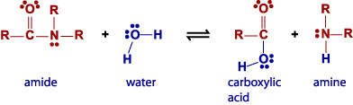
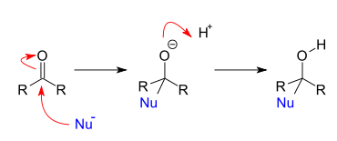
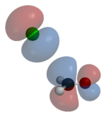
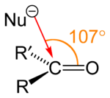
Chemical Reactions
Addition reaction
Electrophilic addition
Nucleophilic addition
Cyclization
Elimination reaction
Beta elimination
E1cB elimination reaction
Organic redox reaction
Pericyclic reaction
Polymerization
Rearrangement reaction
Beckmann rearrangement
Substitution reaction
Electrophilic aromatic substitution
Nucleophilic aromatic substitution
Electrophilic substitution
Nucleophilic substitution
S_{N}1 reaction
S_{N}2 reaction
Notes:
There are chemical rules about what transformations can occur within a cell. Every reaction has a reaction mechanism which is the sequence of distinguishable states from starting material to product. One of these states is the highest energy point, and this state defines the rate of the reaction. The higher that energy, the lower the rate. For a reaction to occur in a cell, its transition state energy must be accessible under atmospheric pressure and temperature, and all the states must not react with water. In practice, this is highly constraining over what reactions get observed.

Slide 3
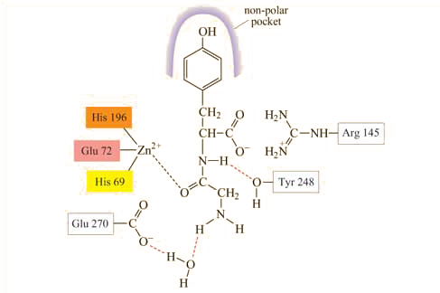
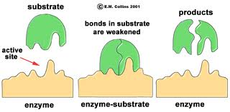
Enzymatic Reactions
E + S
ES
E + P₁ + P₂
Notes:
For biosynthetic devices, primarily we are concerned with the functions of enzymes. Enzymes have active sites that catalyze reactions. Here we illustrate the active site of a zinc protease. Specific residues in the protein, shown in boxes such as “his 196” are oriented in the protein in such a way that they can interact specifically with ligands. Here, a zinc atom is held by a triplet of residues and is used as a lewis acid to activate the amide in the substrate. Other regions of the active site include a non-polar pocket at top (in purple) showing regions of interactions that help bind and recognize the substrate. Through these interactions, an initial binding event between the substrate and the enzyme leads to an intermediate in which the substrate is precisely bound into the active site. By its conformation and orientation relative to a catalytic zinc site, the amide hydrolysis reaction becomes accelerated relative to its spontaneous reaction.
Enzymes cannot make new chemistry happen. In this case, the hyrolysis of an amide is itself something that happens spontaneously when you mix them with water. However, this enzyme-free reaction is so slow that it is not easily observed. The reaction by an enzyme is many orders of magnitude over its spontaneous counterpart.

Slide 4
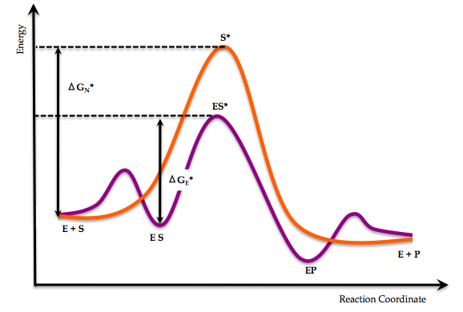
In this energy diagram, where is Kcat?

Slide 5
Enzymatic Reactions
E
E
+
E
P₁
P₁
E
+
+
S
P₂
S
P₂
Non-Covalent Reaction
Covalent Reaction
Non-Covalent Reaction
Notes:
We can describe what’s going on in the enzymatic reaction in terms of transitions in structure. In this diagram, we illustrate the molecules as circles, and indicate non-covalent complexes as lines. An enzyme and a substrate bind to form an ES complex, which can be understood as a transition in the structure of the complexes prsesent. Thus, it is a change in the graph that represents the complex. In the next step, a bond-changing reaction takes place resulting in a modified complex in which the enzyme is bound to two products. Thus, the molecule graph of the substrate has been split into two subgraphs. Finally, a dissociation reaction occurs in which the product-enzyme complex breaks into three separate ones.

Slide 6
Enzymatic Reactions
E
E
+
P₁
E
E
P₁
+
+
S
S
P₂
P₂
Non-Covalent Reaction
Covalent Reaction
Non-Covalent Reaction
Notes:
Let’s focus on just the enzyme in this series of reactions.

Slide 7
Enzymes as a State Machine
State
0
1
2
3
E
+
S
S
E
P2
E
P1
P2
+
P1
+
E
Notes:
We can now describe this system of an enzyme, a substrate, some product molecules in terms of their distinguishable states within the system. So, each step of the reaction sequence represents one such state, there are 4 steps, so there are 4 states to the system. If we examine this system from the perspective of the enzyme, we can simplify things. If the enzyme is not bound to anything it is unaware that they are present, so we can remove them *click*. The 0 and 3 states are now the same. So, E only has 3 distinct *click* states that it is observed to participate in.

Slide 8
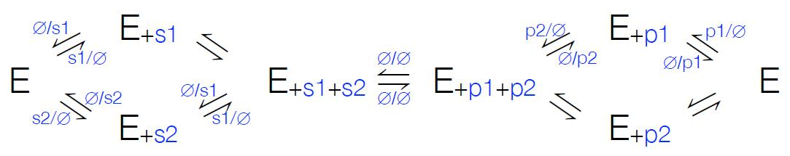
Enzymes as a State Machine
State
S₀
S₁
S₂
Act Formalism : a Mealy Machine
A finite set of states
A start state S₀ (the apo enzyme)
Input and output substrate ‘alphabet’
A transition function mapping pairs of a state and an input to the corresponding next state and output (individual covalent and noncovalent reactions)
E
S
E
P
E
Most common: 2 substrates, 2 products; the bi-bi mechanism
Covalent Reaction
Non-Covalent Reaction
Notes:
We will describe the “world according to E” as 1) the states it can exist in; 2) the allowed transitions for those states; and 3) constraints on the inputs and outputs of these transitions.
*click*
Formally, the data structure this implies is a Mealy machine which defines this set of states, an initial state defined to be the apo- (or free) enzyme, an input and output substrate alphabet, and a transition function.
*click*
This formalism captures the essence of biochemical diagrams such as this one. Most of the enzymes observed in biological systems obey a bi-bi mechanism in which 2 substrates bind and 2 substrates are released by the enzyme. Each reaction links different states of the system, but such diagrams can be directly translated into this Mealy machine formalism.
*click*
In this diagram, some arrows represent transitions in complexation states such as E binding to S to make ES. Others corresponds to transformation of molecule graphs such as the ES to EP step.

Slide 9
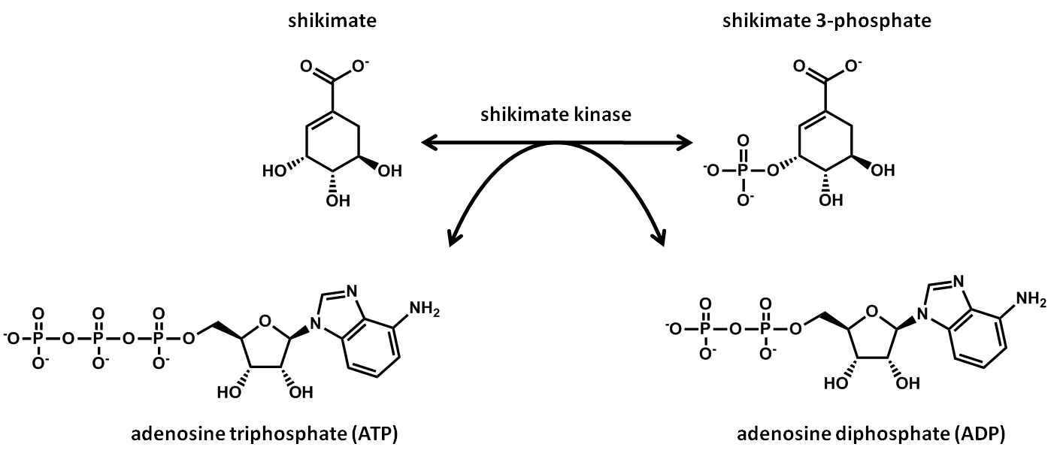
What’s an example of an enzyme that does the bi-bi mechanism?

Slide 10
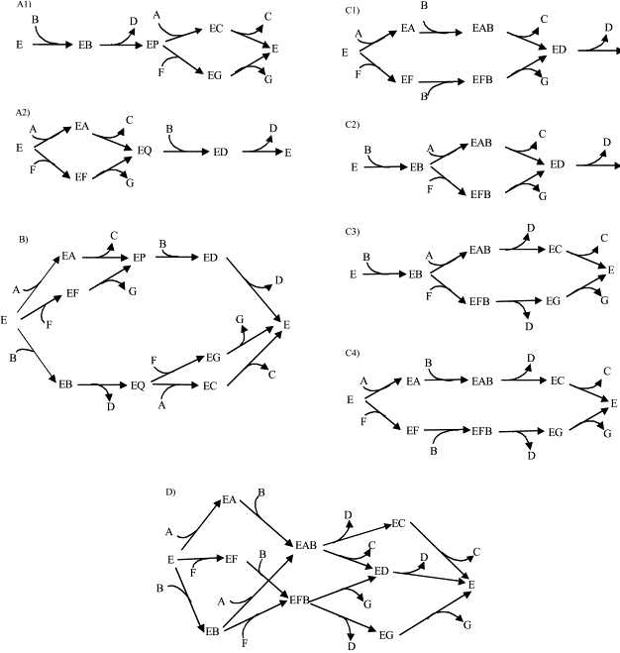
PMID: 12223240

Slide 11
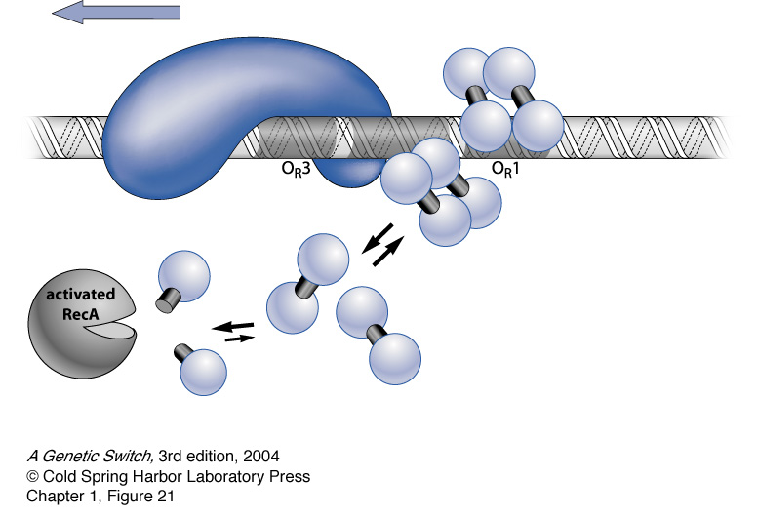
The rest of biochemistry
Lambda repressor
S₃
S₂
S₀
S₁
Notes:
The biochemistry of proteins and metabolites is a rich subject. At the most basic level we have simple enzymes that have been studied for many decades and well-understood. The rest of biochemistry is an extension of the same basic ideas observed in the enzyme system: there are microstates of the participants that involve covalent and noncovalent transitions in structure.
As an example, Here we show the binding of lambda repressor to its operator on a DNA. We can understand this behavior in terms of changes in complexation states of the molecules involved. Here, there are *click* 4 recognizable states.

Slide 12
Summary
Chemical reactions describe spontaneous and stochastic transitions between Molecules
Enzymatic reactions do the same but require non-covalent complexes to catalyze them
Enzymatic reactions follow the same organic chemistry principles as regular reactions
The reactions of an enzyme can be encapsulated as a state machine, and more specifically as a Mealy Machine
The rest of Biochemistry and Molecular Biology can be described similarly in terms of state machines
Notes:
In summary. Chemical reactions are spontaneous and random changes in the structure of molecules and complexes of molecules. Enzymatic reactions do not introduce additional reaction mechanisms to the basic rules of chemistry, but they accelerate select reactions orders of magnitude over their spontaneous counterparts. We can capture biochemical diagrams as a Mealy machine, which is a type of state machine, and from this describe more formally the reactions observed in biology. Though this biochemistry will get fancier, the basic mechanisms are the same, and the formalisms for describing the space are captured by this core idea.

Slide 13
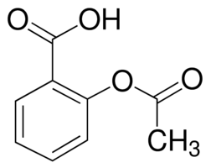
Metabolism and Biosynthesis
Notes:
Metabolism deals with the interaction of the biomolecules in a cell and chemicals from the external environment. By manipulation of these interactions, a cell can be redirected to biosynthesize chemicals of interest or break them down.

Slide 14
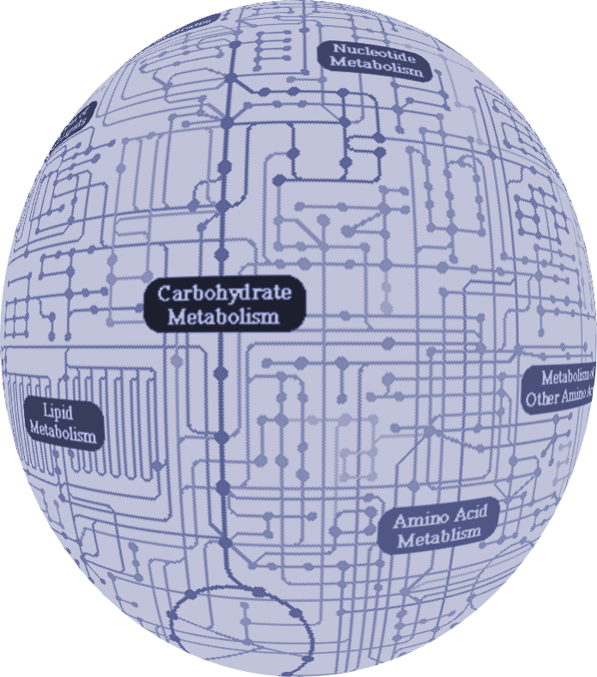
Catabolism
Bioremediation
Biomass Decomposition
Primary Metabolism
Anabolism
Natural Product Biosynthesis
Biofuels
Notes:
Metabolism is typically separated into two topics: catabolism and anabolism. In catabolism, chemicals from the environment such as glucose are deconstructed enzymatically into a set of metabolites that are the ‘primary metabolites’ of the cell. This set of chemicals is largely conserved across all organisms and defines the chemical state of the cell. In anabolism, new molecules are constructed from the primary metabolites. These include natural products, biopolymers, and biotechnology targets such as biofuels.

Slide 15
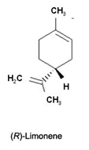
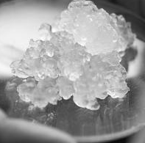
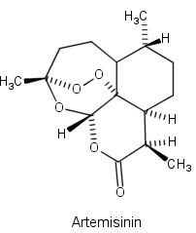
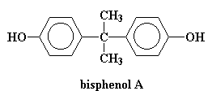
Which of the following is a catabolic process?
Fermentative production of artemisinin
Bioremediation of bisphenol A
Conversion of feathers to limonene
Nanocellulose production
Nanocellulose

Slide 16
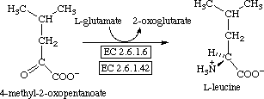
Enzymes
“biomolecules that catalyze (i.e., increase the rates of) chemical reactions. Nearly all known enzymes are proteins.”
In general, enzyme reactions are much more specific than traditional chemical reactions in terms of substrate preference, regiochemistry, and stereochemistry
Anabolic enzymes (often) are very specific to their substrate and reaction
Catabolic enzymes are usually pretty promiscuous, often extracellular, often work on insoluble and polymeric substrates
Primary metabolic enzymes can be specific or promiscuous
Transaminases of E. coli:
aspC
ilvE
tyrB
Notes:
Enzymes define a class of molecules that exhibit cyclical state diagrams and are associated with the domain of living systems. Usually they are proteins or complexes of several proteins. However, there are many examples of RNA-only and RNA-protein complexes, particularly for reactions that involve nucleic acid substrates.
*click*
There are several general characteristics of enzymes you should understand. In general, enzymatic reactions are very specific to their substrate in terms of what molecules they will bind to, where on those molecules they will perform chemistry, and the side of the molecule that they interact with. This gives rise to strict stereoselectivity (the preference for one steroisomer over another) and regioselectivity (preference for one functional group on a molecule over another similar group).
*click*
Though there is not yet a comprehensive survey of enzyme specificity to make such broad-sweeping claims, the general experience is that anabolic enzymes tend to be more specific for their substrates than the catabolic enzymes. Often catabolic enzymes are involved in breaking down insoluble or polymeric substrates, and they have a broad specificity to deal with the many use cases they encounter in the environment.
*click*
The enzymes involved in interconversions between primary metabolites are a mixed bag—some are very precise and others very promiscuous.
*click*
For example, during amino acid biosynthesis the last step is this transamination reaction. Though there are only 3 enzymes capable of doing this chemistry in the cell, that set of enzymes can handle all 20 natural and most unnatural alpha keto-acids.

Slide 17
Where is this ‘promiscuity’?
Most common: 2 substrates, 2 products; the bi-bi mechanism
Covalent Reaction
Non-Covalent Reaction
Notes:
If we go back to our biochemical diagram of a bi-bi enzymatic reaction, we can capture this ‘promiscuity’ primarily in terms of loose constrains on the non-covalent reactions. In general, the chemistry of the covalent reaction of an enzyme is specific, but there will be degeneracy in the compounds that can bind to the enzyme and participate in that reaction mechanism. Largely, it reflects a diversity in shape preference for the enzyme, but the precise molecular transition taking place is quite exact.

Slide 18
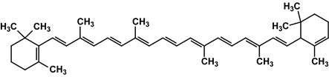
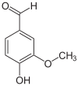
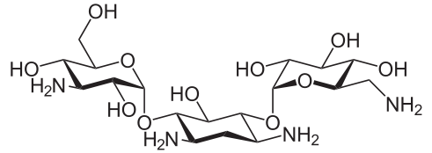
Which of the following is unlikely to be the substrate of a glucosyltransferase?
A) Beta-carotene
B) Vanillin
C) Kanamycin
Notes:
(A). It has no nucleophile that could receive a sugar.

Slide 19
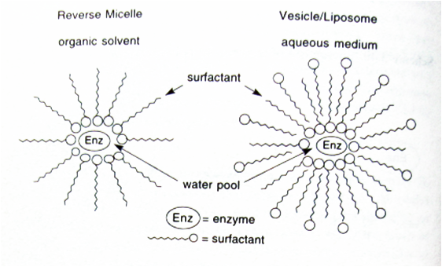
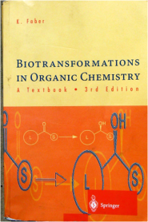
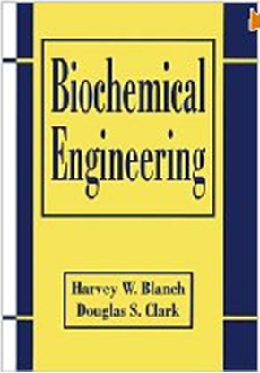
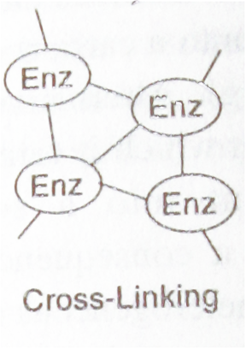
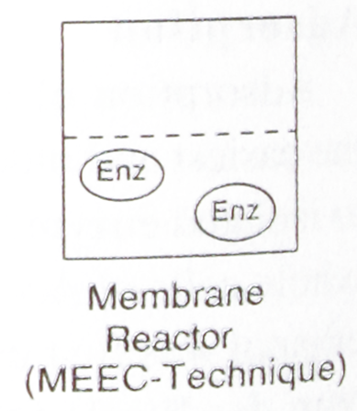
Biocatalysis
“the use of natural catalysts, such as protein enzymes, to perform chemical transformations on organic compounds”
Notes:
Traditionally, enzymes have been exploited for biotechnology purposes in all sorts of ways. The simplest is that of biocatalysis in which the purified enzyme is reacted with a substrate. Such techniques have been thoroughly industrialized and approached from a chemical engineering perspective. There are many issues with the cost of the enzymes, the methods for recycling the catalyst, and methods for dealing with the fact that many of the substrates are hydrophobic, but the enzyme only likes to work in an aqueous environment. These issues are often addressed by compartmentalization strategies such as immobilizing the enzyme in micelles and liposomes, separation of the enzyme from the substrate chamber by membranes, or by forming large aggregates of the enzyme using polymerization chemistries.

Slide 20
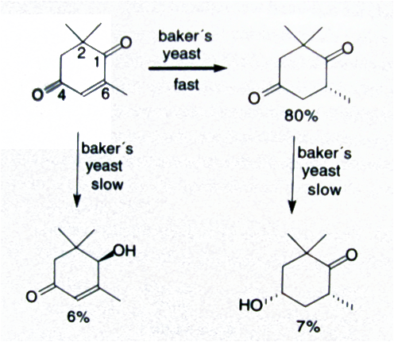
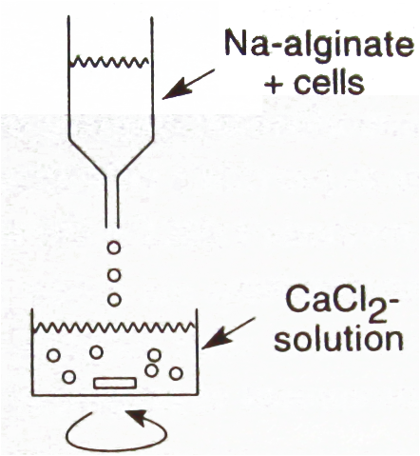
Biotransformation
“the chemical conversion of substances by living organisms”
Usually means reacting a compound with cells, usually immobilized
Doesn’t require purification of the enzymes or addition of cofactors, so it’s cheaper
Usually multiple reactions take place
Usually the cells are ‘dead’
Notes:
A biotransformation is much like a biocatalysis in the sense that it is a chemical process that treats the enzyme-containing sample as a traditional catalyst to convert one substrate to another. In a biotransformation, whole cells are used as the catalyst, and due to their complexity, a large number of reactions are often observed. The cells are not growing under the conditions of the experiment and can be thought of as a limiting case of compartmentalization strategies such as those used for biocatalysis. Often it is necessary to further compartmentalize cells as alginate beads or other means for an efficient process, but many reactions such as oxidations and lipase-style transformations can be easily performed by specific combinations of substrate and organism. Here we show stereoselective and regioselective reductions of ketones in a substrate by biotransformation with baker’s yeast.

Slide 21
Traditional enzyme classifications
EC 1 Oxidoreductases: catalyze oxidation/reduction reactions
EC 2 Transferases: transfer a functional group (e.g. a methyl or phosphate group)
EC 3 Hydrolases: catalyze the hydrolysis of various bonds
EC 4 Lyases: cleave various bonds by means other than hydrolysis and oxidation
EC 5 Isomerases: catalyze isomerization changes within a single molecule
EC 6 Ligases: join two molecules with covalent bonds
http://www.chem.qmul.ac.uk/iubmb/enzyme/
Take Michelle Chang’s biosynthesis course, or another metabolism course, or read Garrett & Grisham’s Biochemistry text
Notes:
Traditionally enzymes are classified according to EC numbers. These 6 general catagories of reactions loosely correlate with reaction mechanisms.

Slide 22

Enzyme classifications
EC 1 Oxidoreductases: catalyze oxidation/reduction reactions
EC 2 Transferases: transfer a functional group (e.g. a methyl or phosphate group)
EC 3 Hydrolases: catalyze the hydrolysis of various bonds
EC 4 Lyases: cleave various bonds by means other than hydrolysis and oxidation
EC 5 Isomerases: catalyze isomerization changes within a single molecule
EC 6 Ligases: join two molecules with covalent bonds
An alcohol dehydrogenase
Notes:
Oxidoreductases catalysis the oxidation and reduction reactions. As a class, they include NADH, FADH2, oxygen, and various other cofactors. The class is defined by the change in oxidation state of atoms during the transformation. Here, an alcohol is being oxidized to a ketone. The electrons are transferred to NAD+ molecules which is reduced to NADH.

Slide 23
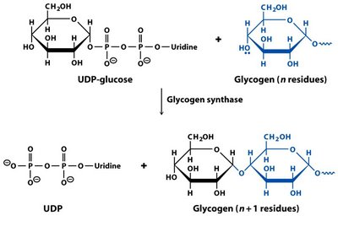
Enzyme classifications
EC 1 Oxidoreductases: catalyze oxidation/reduction reactions
EC 2 Transferases: transfer a functional group (e.g. a methyl or phosphate group)
EC 3 Hydrolases: catalyze the hydrolysis of various bonds
EC 4 Lyases: cleave various bonds by means other than hydrolysis and oxidation
EC 5 Isomerases: catalyze isomerization changes within a single molecule
EC 6 Ligases: join two molecules with covalent bonds
Notes:
Transferases transfer entire moieties from one molecule to another. You can think of the term ‘moiety’ as being one level up from a functional group. They correspond to small unique carbon skeletons that are frequently observed in biomolecules as intact subgraphs. Transferases typically transfer a methyl group, a phosphate, a sugar, or an acyl group from one chemical to another.

Slide 24
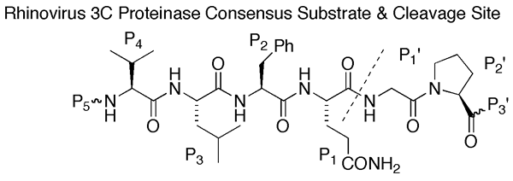
Enzyme classifications
EC 1 Oxidoreductases: catalyze oxidation/reduction reactions
EC 2 Transferases: transfer a functional group (e.g. a methyl or phosphate group)
EC 3 Hydrolases: catalyze the hydrolysis of various bonds
EC 4 Lyases: cleave various bonds by means other than hydrolysis and oxidation
EC 5 Isomerases: catalyze isomerization changes within a single molecule
EC 6 Ligases: join two molecules with covalent bonds
Notes:
Hydryolases are (crudely) the reverse reaction of a transferase. They cleave heteroatom-carbon bonds and thus separate carbon subgraphs within a larger molecule by reaction specifically with water.

Slide 25
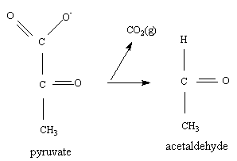
Enzyme classifications
EC 1 Oxidoreductases: catalyze oxidation/reduction reactions
EC 2 Transferases: transfer a functional group (e.g. a methyl or phosphate group)
EC 3 Hydrolases: catalyze the hydrolysis of various bonds
EC 4 Lyases: cleave various bonds by means other than hydrolysis and oxidation
EC 5 Isomerases: catalyze isomerization changes within a single molecule
EC 6 Ligases: join two molecules with covalent bonds
Pyruvate Decarboxylase
Notes:
Lyases cleave bonds my means other than reaction with water. They often involve the breaking of carbon-carbon bonds. Here we show the elimination of carbon dioxide. Note that no redox happened here, but a carbon skeleton was altered due to the reaction.

Slide 26
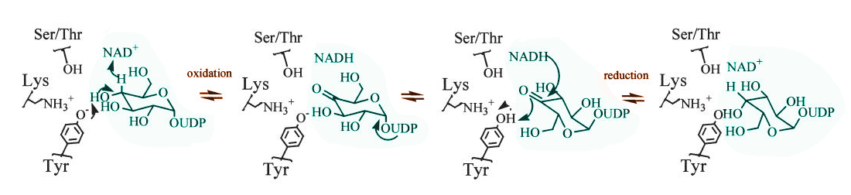
Enzyme classifications
EC 1 Oxidoreductases: catalyze oxidation/reduction reactions
EC 2 Transferases: transfer a functional group (e.g. a methyl or phosphate group)
EC 3 Hydrolases: catalyze the hydrolysis of various bonds
EC 4 Lyases: cleave various bonds by means other than hydrolysis and oxidation
EC 5 Isomerases: catalyze isomerization changes within a single molecule
EC 6 Ligases: join two molecules with covalent bonds
UDP-glucose 4-epimerase
Notes:
Isomerases alter a molecule in a way that does not change its molecular weight. There are epimerases such as the one shown here that flips a stereocenter on the substrate. In other situations, an atom might be moved from one carbon to another. Mechanistically, this is the most poorly defined EC class since many different mechanisms can result in this general characteristic of the substrate and product being isomers of one another. In this example, an NAD+-dependent redox reaction is taking place, but since the net change in oxidation state of the substrate is zero, it is classified as an isomerase instead of an oxidoreductase.

Slide 27
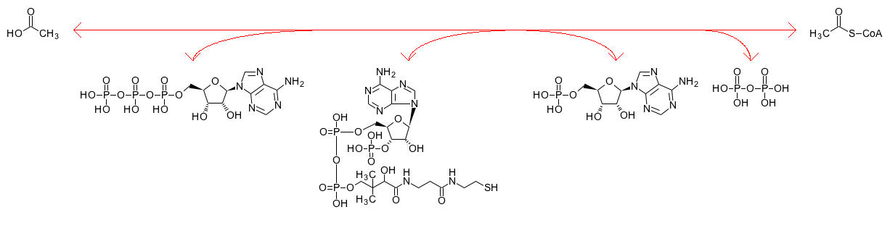
Enzyme classifications
EC 1 Oxidoreductases: catalyze oxidation/reduction reactions
EC 2 Transferases: transfer a functional group (e.g. a methyl or phosphate group)
EC 3 Hydrolases: catalyze the hydrolysis of various bonds
EC 4 Lyases: cleave various bonds by means other than hydrolysis and oxidation
EC 5 Isomerases: catalyze isomerization changes within a single molecule
EC 6 Ligases: join two molecules with covalent bonds
Acetate
Acetyl-CoA
ATP
AMP
PPi
CoA
Acetyl-CoA Ligase
Notes:
Ligases are very similar to transferases in the sense that they involve the transfer of carbon skeleton moieties from one set of molecules to another set. They are typified by the coupling of the reaction mechanism to the hydrolysis of ATP which drives an otherwise thermodynamically unfavorable reaction towards the products.

Slide 28
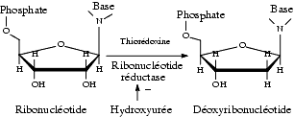
What kind of enzyme is this?
EC 1 Oxidoreductases
EC 2 Transferases
EC 3 Hydrolases
EC 4 Lyases
EC 5 Isomerases
EC 6 Ligases
Notes:
Redox happens on the 2’ carbon, thus is it is an oxidoreductase. The enzyme is ribonucleotide reductase. The word ‘reductase’ is clearly associated with ‘redox’ chemistry.

Slide 29
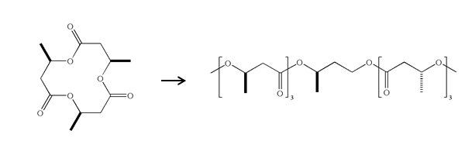
What kind of enzyme is this?
EC 1 Oxidoreductases
EC 2 Transferases
EC 3 Hydrolases
EC 4 Lyases
EC 5 Isomerases
EC 6 Ligases
Notes:
It is breaking of a heteratom-carbon bond with water, thus a hydrolase. The enzyme is ‘lipase’

Slide 30
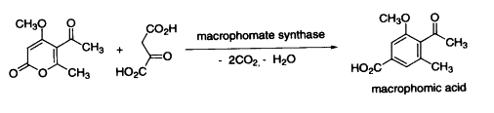
What kind of enzyme is this?
EC 1 Oxidoreductases
EC 2 Transferases
EC 3 Hydrolases
EC 4 Lyases
EC 5 Isomerases
EC 6 Ligases
Notes:
It’s a lyase because CO2 gets released. Note the sloppiness of the term ‘lyase’ which conflicts with the notion of breaking a molecule apart.

Slide 31
Fermentation and
Secondary Metabolism
“1. The anaerobic conversion of sugar to carbon dioxide and alcohol by yeast
2. Carbon conversion from glucose to valuable organic compounds by live cells”
Notes:
Historically, fermentation referred specifically to the process of beer and wine making in which a sugar-rich mixture is converted to carbon dioxide and alcohol by incubation with a yeast. Today, we use the term more generally to refer to the condition in which a microbe is grown in a medium conducive to its growth and the carbon source of the medium is converted to desired carbon-containing products.

Slide 32
In a nutshell…
Step 1: Augment the organism with a sufficient set of enzymes to convert metabolites already available to the cell into the desired product (or vice versa for catabolism) until activity is detectable
Step 2: Optimize the organism by:
Improving the expression of bottleneck enzymes using directed evolution, truncations, or fusion proteins
Trying homologs of the enzymes used in step 1
Finding the expression level of the enzymes that gives rise to optimal product formation
Knocking-up, down, or out native enzymes to increase flux through the desired pathway
Doing system-wide transposon or chemical mutagenesis and screen for improved yield
and maybe get creative…
Re-regulate involved enzymes such as stress promoters
Introduce negative feedback with transcription factors or riboswitches
Compartmentalize or scaffold the enzymes
Notes:
Microbes can be engineered to produce all sorts of chemicals through fermentation. When we speak of biosynthetic devices, we specifically mean a set of enzymes being introduced into an organism that augments those already present to redirect metabolism towards a particular product. Typically, this is a two-step process in which first, the enzymes are identified that will perform the required chemistry needed to reach the product. Then, in step 2
*click*
the performance of that organism is optimized to its theoretical limits. This is often achieved by optimizing how much of each enzyme is produced in the cell, exchanging the choices from step 1 with other enzymes that do the same chemistry but perhaps express better, knocking up, down or altogether removing native enzymes to redirect flux through metabolism to the desire dpathway, and perhaps random mutagenic screens to identify unanticipated improvements to function.
*click*
More recent ideas in this space include steps to re-regulate the enzymes involved through the use of stress-responsive promoters, the introduction of feedback through introduction of additional genes encoding transcription factors and special promoters, or through the inclusion of RNA elements such as riboswitches. Modifications to the biochemistry of the device are also being explored. This includes spatial localization of the reactions through the use of cellular compartments including protein complexes, phage shells, or biomolecular scaffolds.

Slide 33


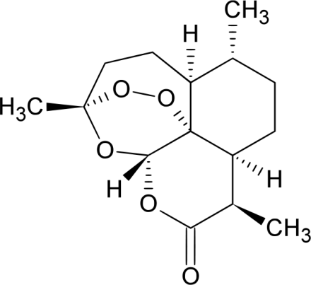
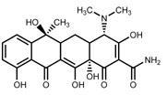
Metabolic Engineering
Traditionally meant to try and make an organism overproduce a compound present on the primary metabolism map
Also involves adding enzymes to create compounds that aren’t part of primary metabolism (secondary metabolites)
Even when producing secondary metabolites, production yields are often limited by flux through primary metabolic pathways
So, much effort goes into increasing the production of key branching-off points for major secondary metabolite classes:
Farnesyl pyrophosphate
(Terpenoid Biosynthesis)
Malonyl-CoA
(Polyketide Biosynthesis)
Artemisinin
Tetracycline
Notes:
Metabolic Engineering refers to the discipline of trying to modify an organism to overproduce a chemical of interest. Historically, these chemicals were limited to those on the primary metabolic map, but in the past few decades, research has focused on grafting biosynthetic pathways from another organism into model organisms such as E. coli and yeast. Even when the target isn’t a native metabolite, the carbon must still be shuttled from glucose in the medium to the product and thus must travel through primary metabolism. Thus, regardless of how complex the biosynthetic pathway is, it is important to optimize flux through some commonly-observed intermediates in the cell. Some metabolites are common choke points for the production of large classes of chemicals.
*click*
For example, all terpenoids come from different chain lengths of pyrophosphates such as farnesyl pyrophosphate. This family of intermediates is present in most organisms, and these go on to produce complex natural products and other primary metabolites. Production of this intermediate is usually the choke point defining how much product can be made. Similarly, the polyketide class is highly dependent on malonyl-CoA, whose production is often limiting. Acetyl-CoA is another common choke point

Slide 34
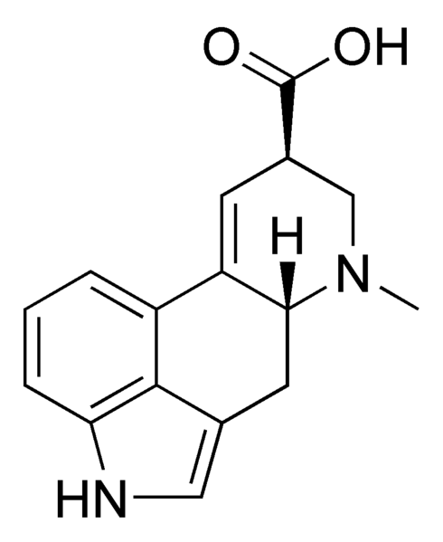
Secondary Metabolites
Small Molecules
Alkaloids
Terpenoids
Glycosides
Polymers
(to be covered in Biosynthesis part 2)
Polyketides
Fatty acids
Nonribosomal peptides
Modified Ribosomal peptides
Lysergic Acid
Notes:
Primary metabolites are those chemicals that are necessary to produce the amino acids and nucleotides from glucose that support the production of proteins and nucleic acids that define the central dogma. The extreme majority of organisms have pretty much the same set of enzymes for making the primary metabolites. Though the line between ‘primary’ and ‘secondary’ is fuzzy, this later category represents those chemicals that cells make that aren’t essential for the central dogma. They exist because they somehow facilitate the organisms survival in its environmental niche. However, they play no role in the central dogma. The class of secondary metabolites can be categorized into several major families defined by their branching-off point from primary metabolism.
*click*
The alkaloids are defined by the presence of an amine which usually originates in an amino acid molecule, and very often that amino acid is tryptophan. The presence of this amine makes them basic molecules since the amine can pick up a proton from water. This property makes them separable using acid-base extraction which procedurally defined the class during the early days of biochemistry. Since the historical classification of alkaloids is based on a physical property rather than a mechanistic or biological basis, this is a mechanistically diverse class which cannot be traced to one specific root primary metabolite in the cell.

Slide 35
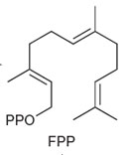
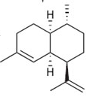
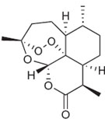
Secondary Metabolites
Small Molecules
Alkaloids
Terpenoids (Isoprenoids)
Glycosides
Polymers
(to be covered in Biosynthesis part 2)
Polyketides
Fatty acids
Nonribosomal peptides
Modified Ribosomal peptides
Cyclase
Individual Enzymes
Notes:
The terpenoids are defined by an origin of the molecule as an isopentenyl, geranyl, farnesyl, or geranyl-geranyl pyrophosphate intermediate. These chemicals are abbreviated as IPP, GPP, FPP, or GGPP and correspond to 1, 2, 3 or more repeats of a repeated *click* isopentenyl unit. These intermediates can be cyclized enzymatically into various hydrocarbons which are further modified by oxidation and transferase reactions.

Slide 36
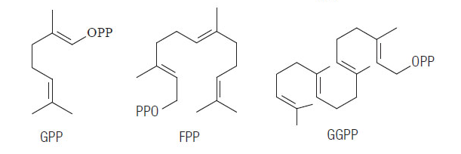
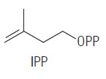
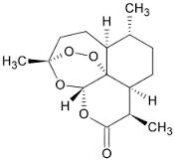
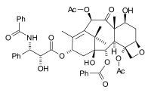
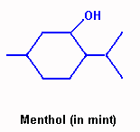

Secondary Metabolites
Small Molecules
Alkaloids
Terpenoids (Isoprenoids)
Glycosides
Artemisinin
Paclitaxel
Notes:
The class is visually identifyable based on having a large all-carbon skeleton with 5, 10, 15, or 20 carbons with methyl groups hanging off every 4th carbon. Many of those carbons will be oxidized and decorated with heteroatoms, but if you ignore all this and just count the carbon atoms, you can see the terpenoid skeleton.

Slide 37
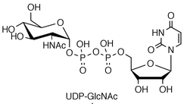
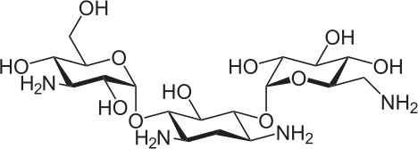
Secondary Metabolites
Small Molecules
Alkaloids
Terpenoids
Glycosides
Polymers
(to be covered in Biosynthesis part 2)
Polyketides
Fatty acids
Nonribosomal peptides
Modified Ribosomal peptides
Glycosyltransferases
Kanamycin
Notes:
Glycosides are molecules composed of sugar moieties linked by glycosidic bonds. This bond is defined by an acetal or ketal linkage where an sp3 carbon is *click* linked to two oxygens. These linkages are made by a subclass of transferases called glycosyltransferase using a cofactor called a nucleotide sugar. Here, UDP-GlcNAc is the sugar donor. This class of cofactors is generated by reaction of the sugar with a nucleotide. The ribonucleotide UTP is the most common nucleotide source, but several other ribo and deoxyribo nucleotides are observed for different sugars. The nucleophile that accepts the sugar moiety is usually an alcohol, and it is very common for it to be another sugar moiety. However, all sorts of nucloephiles on all sorts of chemicals are known to form glycosides using these reactions. Some glycosides are small molecules such as the aminoglycoside anitboiotic kanamycin – this molecule is just three sugars linked together through glycosidic bonds. However, many of the more interesting carbohydrates form polymers of various structures and play important roles in organismal structure and cell-cell communication.

Slide 38
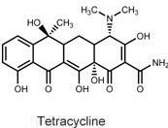

Secondary Metabolites
Small Molecules
Alkaloids
Terpenoids
Glycosides
Polymers
(to be covered in Biosynthesis part 2)
Polyketides
Fatty acids
Nonribosomal peptides
Modified Ribosomal peptides
Notes:
Thus far we have discussed the secondary metabolites that result from monofunctional enzyme reactions. In these biosyntheses, each enzyme does one step of the biosynthetic pathway and is not dependent on the presence of other enzymes to be able to catalyze this reaction. Another class of metabolites are polymeric and depend on polymer-forming reactions that repetitively add similar metabolites to a growing linear chain. We’ll come back to these in a later lecture. The polyketides are one such class frequently observed as antibiotics and other biologically-active substances. They are defined by the reaction of malonate intermediates successively added to an initiating carboxylic acid.
Polyketides are recognizable as all carbon skeletons with usually an even number of carbons. It is common to see methyl groups on every other carbon or at leased spaced evenly across the backbone. Terpenoids always have the methyl groups on the 4th carbon thus the patterning of the carbons allows you to distinguish the classes.

Slide 39

Secondary Metabolites
Small Molecules
Alkaloids
Terpenoids
Glycosides
Polymers
(to be covered in Biosynthesis part 2)
Polyketides
Fatty acids
Nonribosomal peptides
Modified Ribosomal peptides
A depsipeptide macrocyclic lactone
Notes:
The nonribosomal peptides are a class mechanistically related to the polyketides, and it is very common to have hybrid polyketide/nonribosomal peptide products. They are defined by repeated units of amino acids just like proteins. However, they aren’t made on ribosomes, and they often contain non-proteinogenic amino acids such as this *click* bromine-substituted tryptophan residue. Just as glycosides are readily recognizable based on their glycosidic linkage, peptides are identifiable based on their *click* peptide linkages.

Slide 40

Secondary Metabolites
Small Molecules
Alkaloids
Terpenoids
Glycosides
Polymers
(to be covered in Biosynthesis part 2)
Polyketides
Fatty acids
Nonribosomal peptides
Modified Ribosomal peptides
Erythromycin
Notes:
These categorizations of the natural product space are defined by similar reaction mechanisms and branching off points from primary metabolism. However, don’t be fooled into thinking this space is simple or defined cleanly by these categorizations. It is very common to have hybrid metabolites that could be categorized in more than one class. Here, a molecule first synthesized as a polyketide becomes a *click* glycoside through further modification.

Slide 41




Which of the following are glycosides?
A) Vancomycin
B) Paclitaxol
C) Ibogamine
D) Erythromycin
Notes:
A and D both contain glycosidic linkages and are thus glycosides

Slide 42




Which of the following are polyketides?
A) alpha-Ionone
B) Bisabolene
C) Resveratrol
D) Calicheamycin
Notes:
C and D both contain polyketide moieties. D also has sugars and other things, but the ene-diyne core is a polyketide.

Slide 43
Secondary Metabolites
Small Molecules
Alkaloids
Terpenoids
Glycosides
Polymers
(to be covered in Biosynthesis part 2)
Polyketides
Fatty acids
Nonribosomal peptides
Modified Ribosomal peptides
Monofunctional Enzymes
Involve Large, Modular Synthases
Notes:
I have introduced to you two categories of chemicals, small molecules and polymers. The semantics of the term ‘polymer’ is a little fuzzy in this context since these pathways are blended together so often. The basis for these two classes of metabolites is more precisely grouped based on a distinction between the enzymes involved. The small molecule class creates diversity through the use of monofunctional enzymes. These are the ones that work simply by binding to a substrate, doing some chemistry, and then releasing it. The ‘polymer’ class is defined by large polyfunctional megaenzymes that operate like an assembly line. We’ll come back to this when we discuss the polyketides in more detail.

Slide 44
Determining the pathway
(the traditional way)
There are a finite number of synthetic tricks that organisms use to make compounds
Often you can guess the biosynthetic pathway to a given compound based on a sort of retrosynthetic analysis
Mutants of an organism will produce intermediates that can be characterized (but can also generate artifacts)
Can feed the cells isotopically-labeled intermediates (often 13C followed by NMR or MS) and show that a particular compound is part of a biosynthetic pathway, or determine where a particular atom gets incorporated into a molecule
Notes:
If you want to transfer a biosynthetic pathway from one organism to another, you must identify the genes involved. There are a finite number of synthetic tricks that organisms use to make compounds. Because of this, you often can guess the biosynthetic pathway to a given compound based on a retrosynthetic analysis or by homology to known, related pathways.
*click*
Another tool is to use genetics. If the source organism is a microbe, you can easily mutate the organism, screen for a strain that does not produce the product. By examination of cell lysates you can determine what chemical intermediates were lost and correlate this information with the gene that was mutated. Thus, you can deduce the pathway from primary metabolism to product.
*click*
Another tool is to use isotopically-labeled intermediates. If you know, for example, that your pathway needs to include chorismic acid, you could acquire 13C or 1H-labeled chorismic acid, feed it to the organism, and then monitor the appearance of new compounds with the isotope label.
These tools are usually used in conjunction with each other.

Slide 45
Finding the Enzymes
Bacteria are neat and tidy—they tend to keep (most) of the enzymes related to a particular secondary metabolite in operons
Eukaryotes aren’t
Many natural products are produced along with many other related compounds through competing reactions with various enzymes
Sometimes these enzymes aren’t specific to a particular pathway
If the organism is amenable to it, can use genetics to find genes that when removed result in a truncation of the pathway
Can find the enzymes based on homology to similar enzymes (degenerate oligonucleotides, northern blot of cDNA libraries, synthetic metagenomics)
Various genetic selections and screens can be used to sift through cDNA libraries
Can use protein engineering to modify known enzymes to the new activity
Notes:
In bacteria, the task of finding a pathway is usually much simpler than in eukaryotes. Frequent horizontal gene transfer and the ability to make multi-gene operons has the effect of pushing related genes together into clusters. Bacterial genomes are often neat and tidy with large islands dedicated to a particular biosynthetic pathway.
*click*
Eukaryotes are another story. In plant terpenoid biosynthesis, for example, it is very common for many related compounds to be generated through competing reactions with various enzymes. In the genome, these enzymes could be located anywhere and aren’t specific to any one pathway. Thus, prediction is far more difficult.
*click*
Genetic screens, as discussed before, can be used to truncate pathways and thereby identify the involved genes one by one.
*click*
Another approach is to use homology of the enzyme to known enzymes to design degenerate oligonucleotides to fish out candidate genes. When it is realistic to sequence the genome of the organism or its full cDNA, this fishing expedition can be implemented computationally, and such approaches are becoming the norm.
*click*
Another approach involves genetic selections and screens to sift through cDNA libraries.
*click*
If all else fails, protein engineering continues to advance and sometimes an existing enzyme can be modified to accept a substrate that it would not normally accept.
However you do it, a complete cohort of enzymes is required to complete a biosynthetic pathway such that each intermediate from primary metabolism to product is satisfied.

Slide 46
Regulation in Biosynthetic Pathways
Notes:
If you have chosen a set of enzymes that will satisfy a pathway, and you place those genes under the control of a promoter, and put them in a cell, there is a very good chance that the product chemical will be formed. However, there are many reasons why you might not observe the product. It could be chemically unstable, the enzymes might not have expressed properly in the cell, they might not really accept the intermediates, they could kill the cell. Beyond all these possibilities is the various forms of regulation that can take place.

Slide 47
Biosynthetic Pathways
A
B
C
P
Notes:
Consider the example of a three enzyme pathway which will convert compound A to B to C and on to the product. If this system were to exist in isolation with pure enzymes and pure A, the outcome of the system would be readily predictable. One simply writes some differential equations capturing the rate for each enzyme, then solves it as a system to calculate the rate at which P and all the intermediates will form. From this, the concentration of each intermediate at any time can be known.

Slide 48
What is there other than
molecular function?
A
B
C
P
A cellular system
Notes:
When it occurs in a cell, we have a much more complex system, and all sorts of things can happen that affect the outcome on the concentrations of the intermediates and product. To encode this in a cell, we must introduce three enzyme-coding genes into the cell along with promoters, ribosome binding sites, and terminators. Suppose we obtained a chunk of DNA from some other bacterium that contained the native promoter and a native operon of the three genes.

Slide 49
Regulation: Transcriptional Control
A
B
C
P
Negative Feedback
Notes:
One type of regulation that could affect product formation is transcription control. If your product, or any intermediates in route to that product has the effect of shutting down transcription from the promoter, then the enzymes will stop being made and poor yield results.

Slide 50
Regulation: Transcriptional Control
A
B
C
P
Substrate Activation
Ex: arabinose catabolism
Notes:
The opposite situation could also occur in which the product or an intermediate activates transcription. For example, the genes involved in arabinose catabolism are activated by the first chemical (arabinose).

Slide 51
Regulation: Transcriptional Control
A
B
C
P
Changing promoters eliminates transcriptional control
Notes:
The possibility for transcriptional control can be easily eliminated by replacing the promoter with an unrelated one such as a constitutive promoter. This breaks the link between the chemicals being generated and the activity of the promoter.

Slide 52
Regulation: Translational Control
A
B
C
P
Riboswitches
Ex: TPP (thiamine pyrophosphate)
PMID 16356850
Notes:
Another possibility is translational control. Here, the product or intermediates can bind to the mRNAs and alter translation behavior. For example, thiamine pyrosphosphate riboswitches are a common natural feature of enzymes related to that cofactor.

Slide 53
Regulation: Translational Control
A
B
C
P
Shuffled codon usage and changing 5’ UTRs eliminates translational control
Notes:
RNA elements can similarly be eliminated by shuffling the codon usage. For example, there might be a serine codon AGT that overlaps a riboswitch, and mutating it to another serine codon like AGC could break the RNA element. Doing this for all codons in the gene is guaranteed to eliminate any native RNA structure. Thus, any aspects of translational control can be eliminated by codon shuffling.

Slide 54
Regulation: Posttranslational Control
A
B
C
P
Allostery ex: phosphoenolpyruvate inhibition of phosphofructokinase, PMID 2952886
Product inhibition ex: hexokinase, PMID 5460798
Notes:
The most challenging type of regulation is allostery and inhibition. Here, a metabolite binds to an enzyme and alters its reactivity. Many enzymes are product inhibited, such as hexokinase, meaning that accumulation of the product will reduce its function. There are many examples of these posttranslational control mechanisms in primary metabolism. Such behavior can only be modified through protein engineering – there is no easy fix here.

Slide 55
Regulation
A
B
C
P
Introducing regulation into biosynthetic pathways is a very current topic in synthetic biology
Notes:
At any step of control, be it transcriptional, translational, or postranslational, it is possible to remove native regulation or introduce new regulation. Intentionally introducing features such as negative feedback into a design is a very current topic in synthetic biology. It is primarily used to reduce the accumulation of intermediates and optimize the expression level of the enzymes.

Slide 56
What is the lact operon, and what type of regulation is it?
Transcriptional Control
Translational Control
Post-Translational Control

Slide 57
If I put a stop codon into an enzyme and control its expression with a suppressor tRNA, what kind of control is this?
Transcriptional Control
Translational Control
Post-Translational Control

Slide 58
Summary
Metabolic engineering has been around for a long time
It’s a two step process of pathway identification followed by optimization of flux
Usually the targets are ‘secondary metabolites’ which will fit neatly into distinct categories based on the source chemicals and mechanisms of enzymes involved
Extensive regulation, including allostery, greatly complicates things, but is a popular focus of synthetic biology research today
Notes:
In summary:
Metabolic engineering has been around for a long time
It’s a two step process of pathway identification followed by optimization of flux
Usually the targets are ‘secondary metabolites’ which will fit neatly into distinct categories based on the source chemicals and mechanisms of enzymes involved
Extensive regulation, including allostery, greatly complicates things, but is a popular focus of synthetic biology research today

